Slide 1
Dhaka University Calendar Management Application
Submitted by
Pritom Kumar Das(BSSE 0919)
Miran Al Mehrab (BSSE 0931)
Supervised by
Dr. Kazi Muheymin-Us-Sakib
Professor
Institute of Information Technology
University of Dhaka

Slide 2
Introduction
This is an android application that is entitled to the name Dhaka University calendar management application. People can avail this application to be familiar with the Dhaka University.

Slide 3
Background
The calendar committee of Dhaka University publishes a calendar for the first year students of the university to be familiar with the university facilities and its glorious history.

Slide 4
Objective
1. To utilize our knowledge about Software requirement specification, Object oriented programming, Web technology and Database on the project.
2. To minimize the time of getting the calendar for the students.
3. To provide information about the university facilities.
4. To provide communication medium for the first year students.

Slide 5
SCOPE OF THE PROJECT
Only first year students are eligible for registration.
2. Only the registered users have access to the exciting features, such as – group chat, department wise calendar, exciting places.
Only the admin can update the information through provided Interface.
4. This application is developed for android operating system only.

Slide 6
MOTIVATION
1. The will to make university system fully automated.
2. To help the students to make better use of the university facilities.
3. To make the bonding between students and university much stronger.

Slide 7
WORK PLAN
For better management of the project data we have divided our project management into two parts-
1. Static part management
2. Dynamic part management

Slide 8
WORK PLAN
Static Part -
DU information management
Transport Management
General Calendar
Search

Slide 9
WORK PLAN
Dynamic Part -
Map management
Communication Management
3. Calendar Management
4. Providing admins with a separate interface

Slide 10
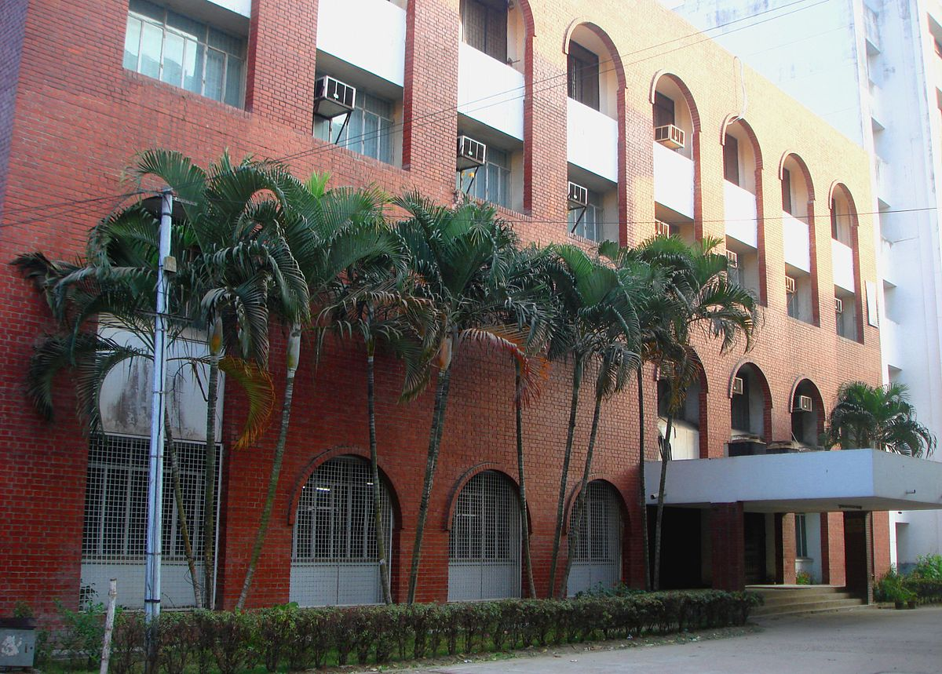
Thank You

